Slide 1
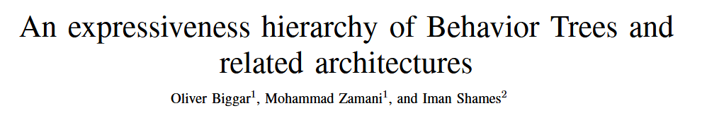
IEEE ROBOTICS AND AUTOMATION LETTERS(RA-L)
Presentor：Yuhan Li

Slide 2
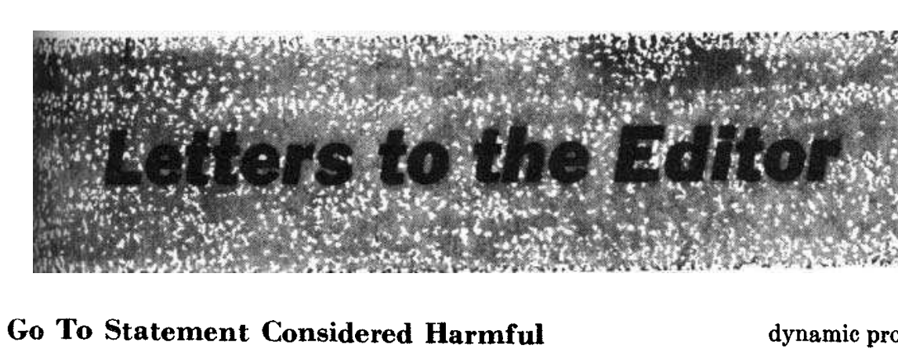

IDEA
structured programming
BT design
Notes:
1968年，Edsger Dijkstra写了一封信，信中认为，通过简单的流控制来组织代码块结构程序，避免了go to语句，从而提高了代码可重用性和可读性。
这导致了后面的结构化编程运动，它允许今天的程序在规模和复杂性上增加数量级，同时仍然是可维护的。
受到这一思想的启发，本文作者研究了BT和其他类似控制结构的表现力，并描述了BT设计中表现力和可读性之间的权衡。

Slide 3

CONTRIBUTIONS
Provide a formal framework for comparing the expressive power of Behavior Trees (BTs) to other action selection architectures.
Teleo-reactive Programs (TRs)
Decision Trees (DTs)
Finite State Machines (FSMs)
BT
Show the trade-off in BT design between readability and expressiveness
Notes:
辅助变量

Slide 4
expressiveness: breadth of behaviors that they can theoretically construct
readability: a control architecture is readable if there is a close correlation between its visual structure and the behavior it induces in a robot.

Slide 5


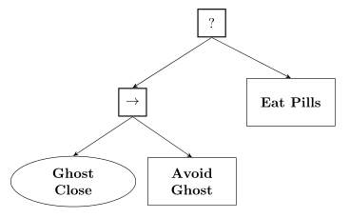
Action Selection Mechanism (ASM)
a map f : Σ∗ → A
If there is a finite set K of Boolean variables used to make task selections then Σ = 2^{K} , where each x ∈ Σ is the set of variables true at that point.
K=2：幽灵接近，幽灵没接近
K=2+：躲避幽灵成功/失败，…
幽灵接近→躲避幽灵
幽灵没接近→吃大力丸
吃大力丸
幽灵
接近
躲避幽灵

Slide 6

Action Selection Mechanism (ASM)
a map f : Σ∗ → A
an ASM responds to sequences of input (from Σ) with sequences of actions (from A)

Slide 7
？
How to Formalizing
Control Architectures
AS ASMs

Slide 8
Behavior Trees(BTs)
幽灵接近，幽灵没接近
幽灵接近→躲避幽灵
幽灵没接近→吃大力丸
吃大力丸
幽灵
接近
躲避幽灵
（omit discussion of the Parallel）
the conditions for returning Success, Failure and Running are formulated on K
Action nodes are the actions
On each input x_{i} ∈ Σ, we tick (execute) the tree starting from the root, and select the leaf node that was ticked last in the traversal of the tree.

Slide 9

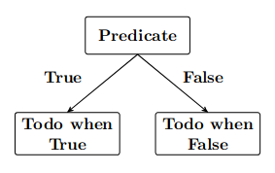
Teleo-reactive Programs(TRs)
&Decision Trees (DTs)
幽灵接近 -> 躲避幽灵
幽灵没接近 -> 吃大力丸
幽灵是否接近
是
否
躲避幽灵
吃大力丸
Notes:
远程反应程序和二叉决策树

Slide 10
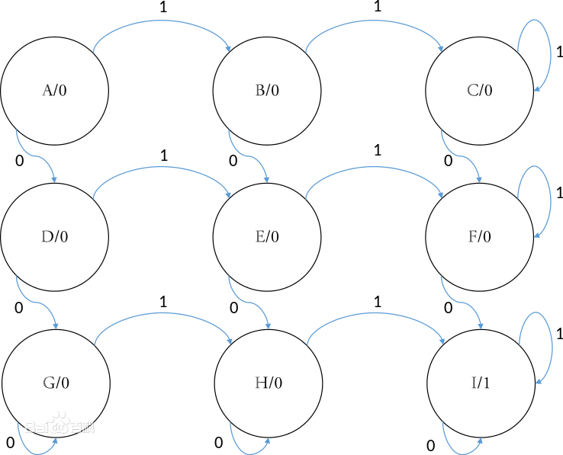
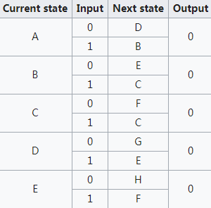
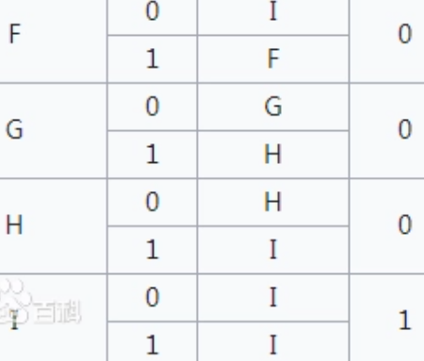
Finite State Machines(FSM)
an FSM(Moore machine) is a six-tuple (Q, q0, Σ, A, δ, ℓ)
Q is a finite set of states
q0 ∈ Q is the initial state
Σ is a finite set of inputs
A is a finite set of outputs(actions)
transition function δ : Σ × Q → Q
output function ℓ : Q → A
Notes:
the transition function dictating when transitions are triggered
the output function assigning states to actions
当至少有两个0和两个1作为输入时，输出变为1并且此后保持为1

Slide 11
Reactiveness
Definition 3.2: A reactive architecture is one whose ASM f : Σ∗ → A can be expressed by a single map r : Σ → A, so f (x₀ . . . x_{n}) = r(x_{n}).
FSM
X
BTs
TRs
DTs
躲避
成功
幽灵近
杀死幽灵
开始
幽灵远
幽灵近
吃大
力丸
√
幽灵远
幽灵远
追逐幽灵

Slide 12
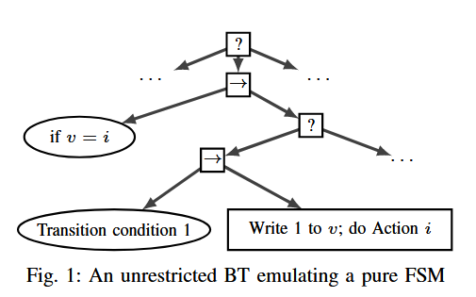
Expressiveness
Definition 4.1：define a pure X as an ASM f from an X with f : Σ∗ → A. Then, we define an unrestricted X as an ASM g from an X with g : (2K × P )∗ → (A × Y).
v denote an auxiliary integer variable which can store n different values i ∈ {1, . . . , n}.
Y denote the set of actions of the form ‘Write i to v’
P denote the set of propositions of the form ‘v = i ?’ for any i ∈ {1, . . . , n}.
Notes:
Let X be a class of control architectures, such as BTs or FSMs.
Let v denote an auxiliary integer variable which can store n different values i ∈ {1, . . . , n}.
Let Y denote the set of actions of the form ‘Write i to v’
let P denote the set of propositions of the form ‘v = i ?’ for any i ∈ {1, . . . , n}.
Recalling our usual input and action sets Σ = 2^{K} and A

Slide 13
Expressiveness
Definition 4.2: Let X and Z be two classes of ASMs. We say X is more expressive than Z if Z ⊂ X, and equally expressive if Z = X.
Lemma 4.3: pFSM ⊆ uBT
Notes:
FSM的状态从1到n编号

Slide 14
Expressiveness
Definition 4.2: Let X and Z be two classes of ASMs. We say X is more expressive than Z if Z ⊂ X, and equally expressive if Z = X.
Lemma 4.3: pFSM ⊆ uBT
Theorem 4.4 (The ASM Hierarchy):
pTR = pDT = pBT = Reactive ⊂
uTR = uDT = uBT = pFSM = uFSM
write Reactive for the set of all reactive ASMs with input from 2^{K} and actions A.
Notes:
FSM的状态从1到n编号

Slide 15


Expressiveness & Readability
Improves expressiveness
Readability
Modularity
Reactiveness
Improve expressiveness
Notes:
First, the order of the subtrees is irrelevant, so the visual information of order is unused.
Secondly, contrary to one of the key benefits of BTs, considering each subtree in isolation does not allow one to understand the behavior.
Finally, the structure of each individual selection does not convey which sequences of selections are possible, as it is not reactive.

Slide 16
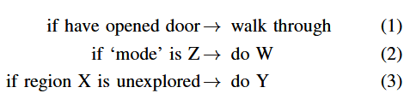
Expressiveness & Readability
Selection of Conditions
If door open
Internal ‘map’
Notes:
依赖过去的状态

Slide 17
Expressiveness & Readability
memory nodes
Notes:
依赖过去的状态

Slide 18
Memory Nodes
Improves expressiveness
Sequence and Fallback with memory：
→∗ ?∗
If the Sequence with memory returns Success or Failure, then the memory is ‘reset’, and on the next received tick it begins at the leftmost node.
Run until Success (Failure) or eternal memory：
It’s a decorator node ticks its one child and returns that child’s return value until the child returns Success, after which the Decorator returns Success always.

Slide 19
Theorem 4.5: Let mBT be the set of ASMs which are derived from pure BTs with eternal memory and control flow nodes with memory allowed. Then pBT ⊂ mBT ⊂ uBT.
Improves expressiveness
Step1：pBT ⊂ mBT
‘do A until it returns Success, then do B forever’
→
→
A
B
A
B

Slide 20
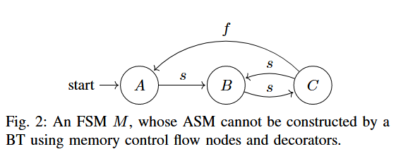
Improves expressiveness
Theorem 4.5: Let mBT be the set of ASMs which are derived from pure BTs with eternal memory and control flow nodes with memory allowed. Then pBT ⊂ mBT ⊂ uBT.
Step2： mBT ⊂ FSM = uBT

Slide 21
input sequence z = (r, r, r), (s, r, r), (r, s, r), (r, f, s), (r, s, r), (r, r, f ),which M selects y = A, B, C, B, C, A
inputs x = (v_{A}, v_{B}, v_{C} ) ∈ Σ, v_{A}, v_{B} and v_{C} are the return values in x of A, B and C【s(Success),f(Failure),r(Running)】
Suppose we apply the input sequence z^{n} to M , Suppose the actions selected by T on the nth copy of z are identical to the selections for the (n − 1)-th copy

Slide 22
Theorem 4.4 + Theorem 4.5：
pTR = pDT = pBT = Reactive ⊂ mBT ⊂
uTR = uDT = uBT = pFSM = uFSM

Slide 23
THANK YOU

